Slide 1
Dynamic Programming: Maximum subarray sum
Session 15
Henry Lucky, S.Kom., M.Kom.

Slide 2
Learning Outcomes
Session 15
This session addresses:
LO 2: Analyze unfamiliar computational problems by identifying their structural properties, classifying them into known algorithmic categories including graph, string, and combinatorial problems and recommending a solution strategy with justification.
LO 3: Design solutions to unfamiliar computational problems by selecting and applying appropriate strategies including Divide and Conquer, Greedy, Dynamic Programming, and Backtracking.

Slide 3
Learning Outcomes
Session 15
By the end of this session, students will be able to:
LO 2 – Identify optimal substructure and overlapping subproblems as conditions for applying DP; distinguish DP from greedy (no re-evaluation) and D&C (independent subproblems); classify Kadane's algorithm as DP by recognizing its state-dependent decision.
LO 3 – Design Kadane's algorithm using the recurrence dp[i] = max(A[i], dp[i-1]+A[i]); apply the four-step DP design process (characterize → define → compute → construct); implement both memoization and tabulation.

Slide 4
outline
Session 15
DP Paradigm — Optimal Substructure and Overlapping Subproblems
Memoization vs. Tabulation
Maximum Subarray Sum: Kadane's Algorithm
Why Kadane's is DP and Not Greedy

Slide 5
Dynamic Programming paradigm
Why DP?
Compute fib(5) by hand recursively. Draw the recursion tree.
Question: how many times do we compute fib(2)? How about fib(3)?
FIB(n)
1 if n <= 1
2 return n
3 return FIB(n - 1) + FIB(n - 2)

Slide 6
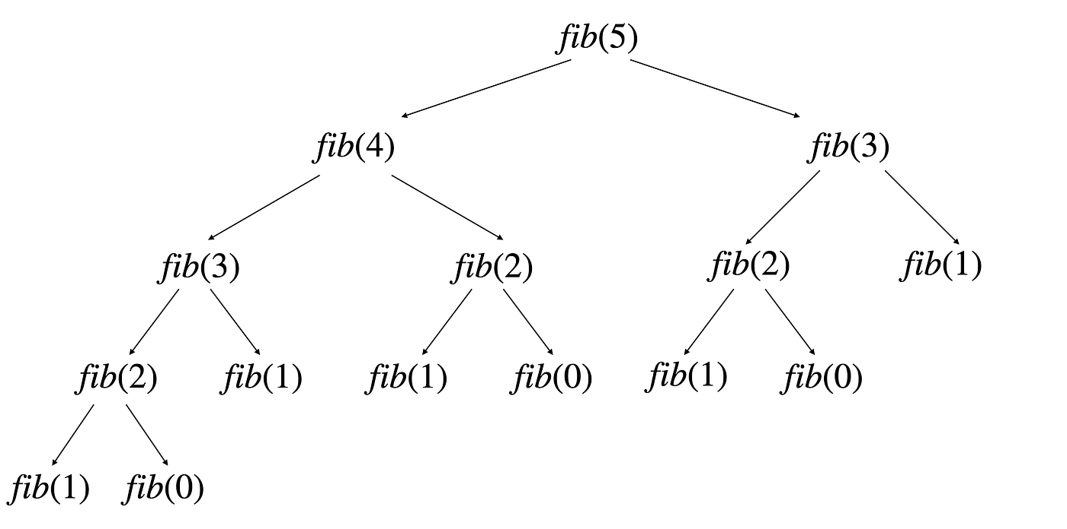
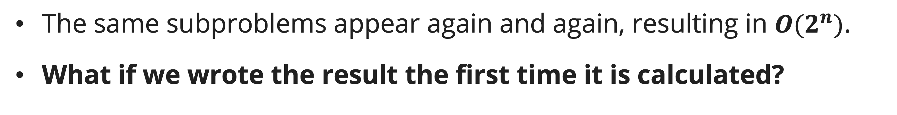
Dynamic Programming paradigm
Why DP?
The same subproblems appear again and again, resulting in $O(2^{n})$.
What if we wrote the result the first time it is calculated?

Slide 7

Dynamic Programming paradigm
Why DP?
Here, we save the first call in an array called memo, so each subproblem solved at most once, resulting in $O\left(n\right)$ time complexity.
MEMOIZED-FIB(n)
1 let memo[0..n] be a new array
2 for i = 0 to n
3 memo[i] = NIL
4 return MEMOIZED-FIB-AUX(n, memo)
MEMOIZED-FIB-AUX(n, memo)
1 if n <= 1
2 return n
3 if memo[n] != NIL //if saved, no need to recalculate
4 return memo[n]
5 memo[n] = MEMOIZED-FIB-AUX(n – 1, memo) + MEMOIZED-FIB-AUX(n – 2, memo)
6 return memo[n]

Slide 8
Dynamic Programming paradigm
Why DP?
The resulting recursion tree will looks like this.
The same subproblems are called, but not calculated further.

Slide 9
Dynamic Programming paradigm
Definition
Dynamic Programming (DP) is an algorithm design technique for solving problems with overlapping subproblems and optimal substructure by storing intermediate results.
DP is applicable when:
  Optimal substructure: The optimal solution to the problem contains optimal solutions to subproblems.
  Overlapping subproblems: The same subproblems are solved repeatedly in a naïve recursive solution.
This contrasts with Divide-and-Conquer (independent subproblems) and Greedy (single greedy choice with optimal substructure).

Slide 10
Dynamic Programming paradigm
Two implementations
Top-down (Memoization): Write the natural recursion; cache results to avoid recomputation.
Bottom-up (Tabulation): Fill a table in an order ensuring subproblems are solved before they are needed.
The implementation in slide 7 is a Top-down (Memoization) implementation.
Can we make it to Bottom-up implementation?

Slide 11

Dynamic Programming paradigm
Bottom-up fibonacci
Here, we initialize the array dp and starting to calculate Fibonacci value starting from 2 to n, resulting in $O\left(n\right)$ time complexity.
FIB-DP(n)
1 let dp[0..n] be a new array
2 dp[0] = 0
3 dp[1] = 1
4 for i = 2 to n
5 dp[i] = dp[i - 1] + dp[i - 2]
6 return dp[n]

Slide 12
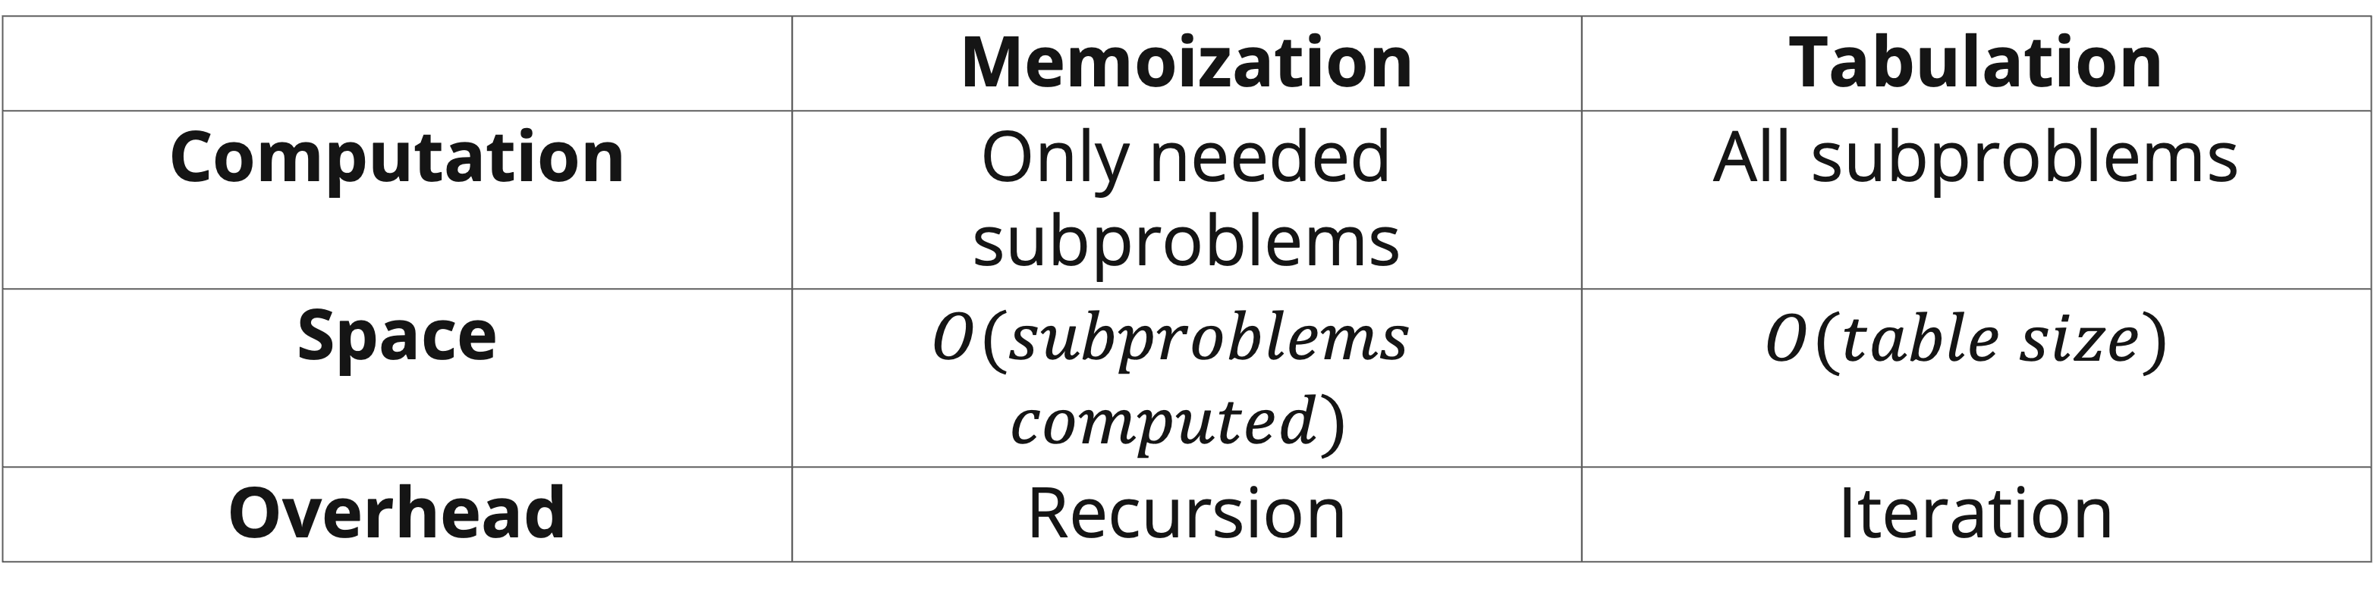
Dynamic Programming paradigm
Top-down vs bottom-up
 | Memoization | Tabulation
Computation | Only needed subproblems | All subproblems
Space | $$O(subproblems$$ $$computed)$$ | $$O(table size)$$
Overhead | Recursion | Iteration

Slide 13
Dynamic Programming paradigm
Design steps
Generally, there are 4 steps to design a DP algorithm:
Characterize the structure of an optimal solution.
Define the value of an optimal solution recursively.
Compute the value bottom-up (or top-down with memoization).
Construct an optimal solution from the computed information.

Slide 14
Maximum Subarray Sum: Kadane's Algorithm
problem
Given an array A[1..n] of integers (possibly negative), find the contiguous subarray A[i..j] with the maximum sum.
Example: A = [−2, 1, −3, 4, −1, 2, 1, −5, 4] → Maximum subarray: A[4..7] = [4, −1, 2, 1], sum = 6.
−2 | 1 | −3 | 4 | −1 | 2 | 1 | −5 | 4
1 | 2 | 3 | 4 | 5 | 6 | 7 | 8 | 9

Slide 15

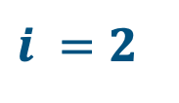
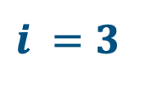
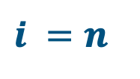
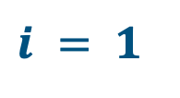
Maximum Subarray Sum: Kadane's Algorithm
Naïve Approach
For every index $i$, there are $i$ possible subarrays ending exactly at that index.
Therefore, there are $1+2+3+…+n=O(n^{2})$possible subarrays.
For each possible subarray, calculating the sum cost $O(n)$, so the total time complexity is $O(n^{3})$.
$$i = 1$$
$$i =2$$
$$i =3$$
$$i =n$$
1 | 2 | 3 | … | n
1 | 2 | 3 | … | n
1 | 2 | 3 | … | n
1 | 2 | 3 | … | n
1 | 2 | 3 | … | n
1 | 2 | 3 | … | n
…
1 | 2 | 3 | … | n
1 | 2 | 3 | … | n

Slide 16
Maximum Subarray Sum: Kadane's Algorithm
Naïve approach
BRUTE-FORCE-SUM(A)
1 n = A.length
2 if n == 0
3 return 0
4 global_max = -∞
5 for end = 1 to n //for every end index
6 for start = 1 to end //search for every possible start index
7 current_subarray_sum = 0
8 for i = start to end //calculate the sum of the subarray
9 current_subarray_sum = current_subarray_sum + A[i]
10 global_max = max(global_max, current_subarray_sum)
11 return global_max
Notes:
n = length of array, this is a 1-based array

Slide 17
Maximum Subarray Sum: Kadane's Algorithm
Naïve Approach: Overlapping Subproblems
Overlapping subproblems happens everywhere here, for example:
On a closer look, we actually only care about the previous maximum sum for the current ending index
So, what if we save the maximum sum for every ending index?
$$i = 1$$
$$i =2$$
$$i =3$$
$$i =n$$
1 | 2 | 3 | … | n
1 | 2 | 3 | … | n
1 | 2 | 3 | … | n
1 | 2 | 3 | … | n
1 | 2 | 3 | … | n
1 | 2 | 3 | … | n
…
1 | 2 | 3 | … | n
1 | 2 | 3 | … | n

Slide 18
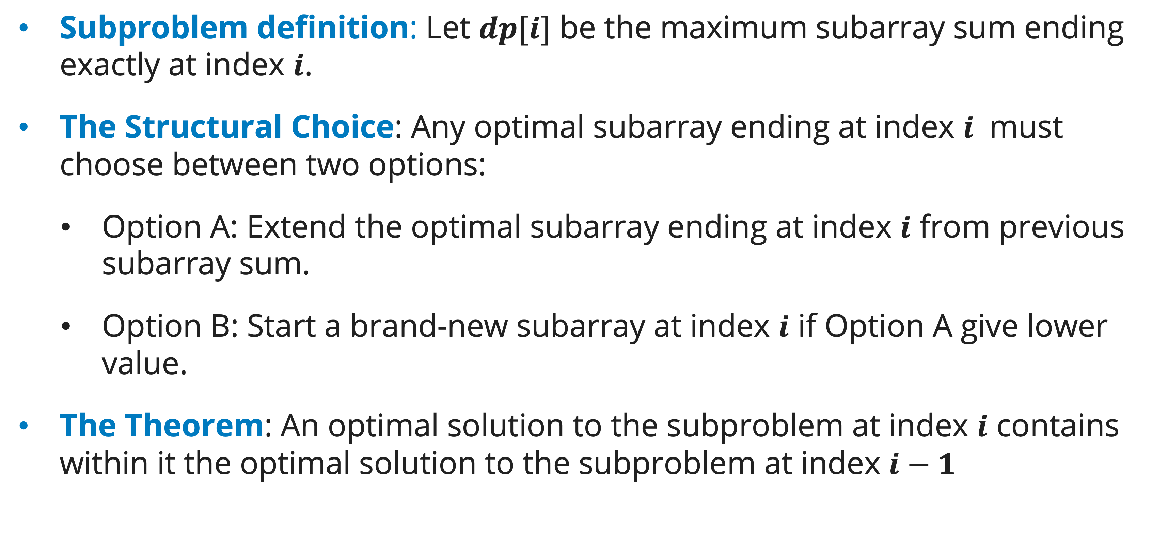
Maximum Subarray Sum: Kadane's Algorithm
Step 1 – Characterize the Structure: Optimal Substructure property
Subproblem definition: Let $dp[i]$ be the maximum subarray sum ending exactly at index $i$.
The Structural Choice: Any optimal subarray ending at index $i$ must choose between two options:
  Option A: Extend the optimal subarray ending at index $i$ from previous subarray sum.
  Option B: Start a brand-new subarray at index $i$ if Option A give lower value.
The Theorem: An optimal solution to the subproblem at index $i$ contains within it the optimal solution to the subproblem at index $i−1$

Slide 19
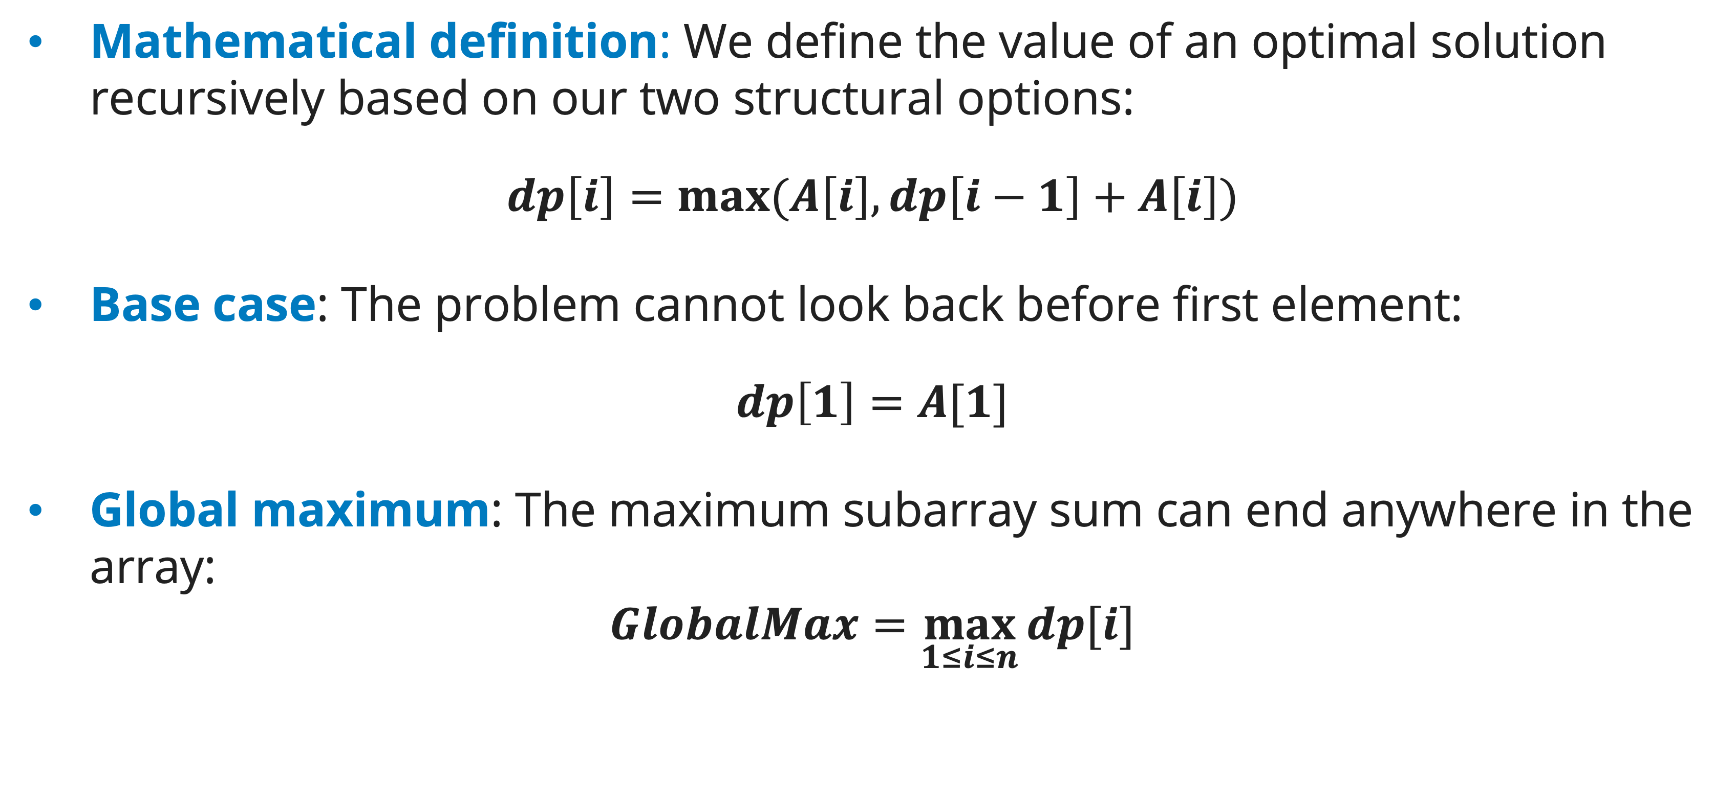
Maximum Subarray Sum: Kadane's Algorithm
Step 2 – Define optimal solution recursively: recurrence relation
Mathematical definition: We define the value of an optimal solution recursively based on our two structural options:
$$dp\left[i\right]=max⁡(A\left[i\right], dp\left[i−1\right]+A\left[i\right])$$
Base case: The problem cannot look back before first element:
$$dp\left[1\right]=A[1]$$
Global maximum: The maximum subarray sum can end anywhere in the array:
$$GlobalMax=\max_{1≤i≤n}{dp[i]}$$
Notes:
We define the value of an optimal solution recursively based on our two structural options:

Slide 20
Maximum Subarray Sum: Kadane's Algorithm
Step 3 – Compute the Value Bottom-Up
KADANE-TABLE(A)
1 n = A.length
2 let s[1..n] be a new array
3 dp[1] = A[1]
4 global_max = A[1]
5 for i = 2 to n
6 dp[i] = max(A[i], dp[i - 1] + A[i])
7 if dp[i] > global_max
8 global_max = dp[i]
9 return global_max
Here, we only ever look at $dp[i−1]$to compute $dp[i]$. We can optimize the space by dropping the array and just use one variable to track the state.
Notes:
n = length of array, this is a 1-based array

Slide 21
Maximum Subarray Sum: Kadane's Algorithm
Step 3 – Compute the Value Bottom-Up
KADANE-SPACE-OPTIMIZED(A)
1 n = A.length
2 curr_max = A[1]
3 global_max = A[1]
4 for i = 2 to n
5 curr_max = max(A[i], curr_max + A[i])
6 if curr_max > global_max
7 global_max = curr_max
8 return global_max
By optimizing like this, we reduce the space complexity from$O(n)$to $O(1)$. DP algorithm is not always about table.
Notes:
n = length of array, this is a 1-based array

Slide 22
Maximum Subarray Sum: Kadane's Algorithm
Step 3 – Compute the Value Bottom-Up
FIB-SPACE-OPTIMIZED(n)
1 if n == 0 return 0
2 prev2 = 0
3 prev1 = 1
4 for i = 2 to n
5 curr = prev1 + prev2
6 prev2, prev1 = prev1, curr
7 return prev1
In fact, you may have done this in Fibonacci before.

Slide 23
Maximum Subarray Sum: Kadane's Algorithm
Step 4 – Construct the solution: Tracking Indices to Rebuild the Subarray
So, we have got the optimal solution.
Now, what if we want to know from which subarray does the solution come from?
To output the subarray, we need the indices information, so track index boundaries when values change:
  Expansion Rule: If curr_max reset, the start boundary shift to current index.
  Global Rule: If new global maximum is achieved, update the start and end boundaries permanently.

Slide 24
Maximum Subarray Sum: Kadane's Algorithm
Step 4 – Construct the solution: Tracking Indices to Rebuild the Subarray
KADANE-CONSTRUCT(A)
1 n = A.length
2 curr_max = A[1]
3 global_max = A[1]
4 start = 1; end = 1; temp_start = 1
5 for i = 2 to n
6 if A[i] > curr_max + A[i]
7 curr_max = A[i]
8 temp_start = i
9 else curr_max = curr_max + A[i]
10 if curr_max > global_max
11 global_max = curr_max
12 start = temp_start
13 end = i
14 return A[start..end] with sum global_max
Notes:
n = length of array, this is a 1-based array

Slide 25
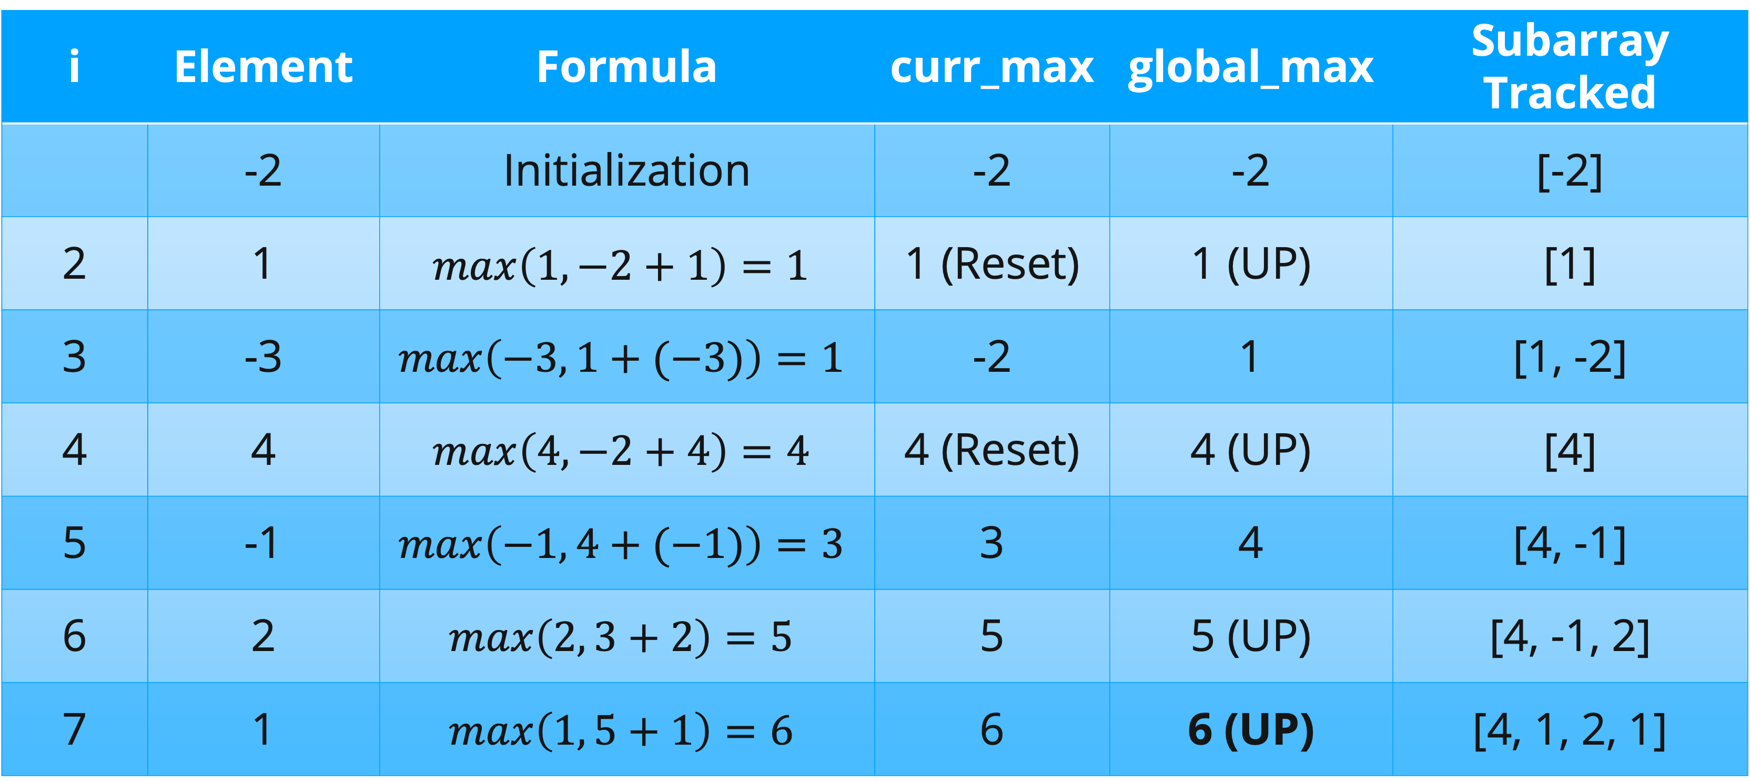
Maximum Subarray Sum: Kadane's Algorithm
Trace on array = [-2, 1, -3, 4, -1, 2, 1]
i | Element | Formula | curr_max | global_max | Subarray Tracked
 | -2 | Initialization | -2 | -2 | [-2]
2 | 1 | $$max\left(1, −2+1\right)=1$$ | 1 (Reset) | 1 (UP) | [1]
3 | -3 | $$max\left(−3, 1+(−3)\right)=1$$ | -2 | 1 | [1, -2]
4 | 4 | $$max\left(4, −2+4\right)=4$$ | 4 (Reset) | 4 (UP) | [4]
5 | -1 | $$max\left(−1, 4+(−1)\right)=3$$ | 3 | 4 | [4, -1]
6 | 2 | $$max\left(2, 3+2\right)=5$$ | 5 | 5 (UP) | [4, -1, 2]
7 | 1 | $$max\left(1, 5+1\right)=6$$ | 6 | 6 (UP) | [4, 1, 2, 1]

Slide 26
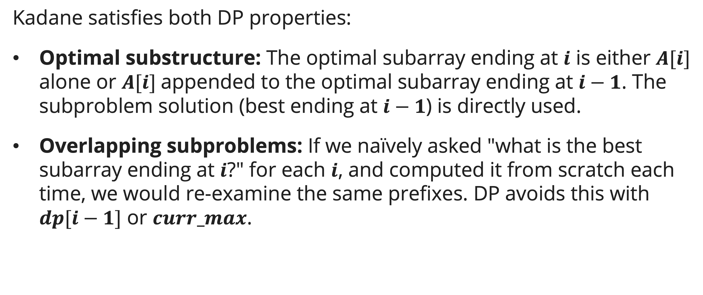
Why Kadane's is DP and Not Greedy
DP identification
Kadane satisfies both DP properties:
Optimal substructure: The optimal subarray ending at $i$ is either $A[i]$ alone or $A[i]$appended to the optimal subarray ending at $i−1$. The subproblem solution (best ending at $i−1$) is directly used.
Overlapping subproblems: If we naïvely asked "what is the best subarray ending at $i$?" for each $i$, and computed it from scratch each time, we would re-examine the same prefixes. DP avoids this with $dp[i−1]$ or $curr_max$.

Slide 27
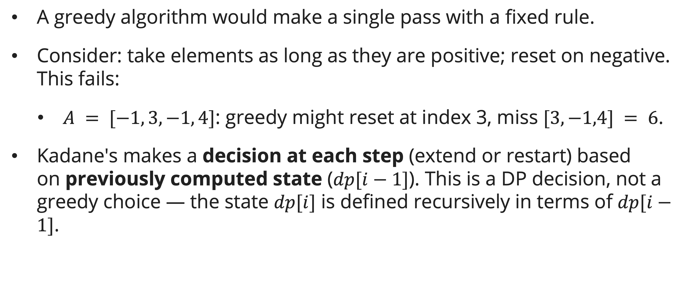
Why Kadane's is DP and Not Greedy
Why not greedy
A greedy algorithm would make a single pass with a fixed rule.
Consider: take elements as long as they are positive; reset on negative. This fails:
  $A = [−1, 3, −1, 4]$: greedy might reset at index 3, miss $[3,−1,4] = 6$.
Kadane's makes a decision at each step (extend or restart) based on previously computed state ($dp[i−1]$). This is a DP decision, not a greedy choice — the state $dp[i]$ is defined recursively in terms of $dp[i−1]$.

Slide 28
Why Kadane's is DP and Not Greedy
DP vs greedy
Property | Greedy | Dynamic Programming
How it decides? | Uses only raw input data/heuristic available right now/at current step | Uses previously computed subproblem states
Decision Pipeline | Makes a choice before solving subproblems | Makes a choice after evaluating previous subproblems
Can it look back? | No. It makes a choice and never revisits or relies on a calculated state table. | Yes. It must read from the table/state of a solved subproblem to make the current calculation.
Examples | Activity Selection, Fractional Knapsack, Huffman Code, Dijkstra | Max Subarray Sum, 0/1 Knapsack, Coin Change (Non Canonical)

Slide 29
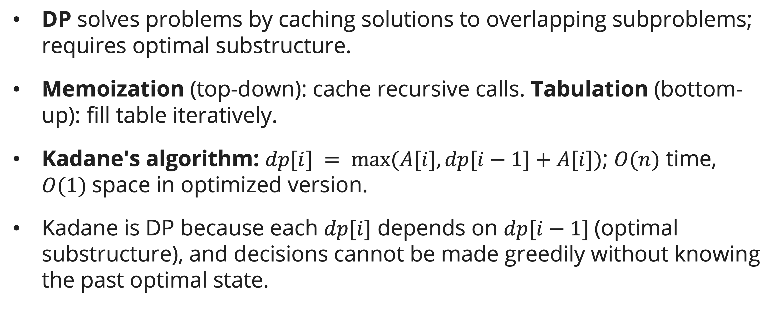
Summary
Session 15
DP solves problems by caching solutions to overlapping subproblems; requires optimal substructure.
Memoization (top-down): cache recursive calls. Tabulation (bottom-up): fill table iteratively.
Kadane's algorithm: $dp[i] = max⁡(A[i], dp[i−1]+A[i])$; $O(n)$ time, $O(1)$space in optimized version.
Kadane is DP because each $dp[i]$ depends on $dp[i−1]$(optimal substructure), and decisions cannot be made greedily without knowing the past optimal state.

Slide 30
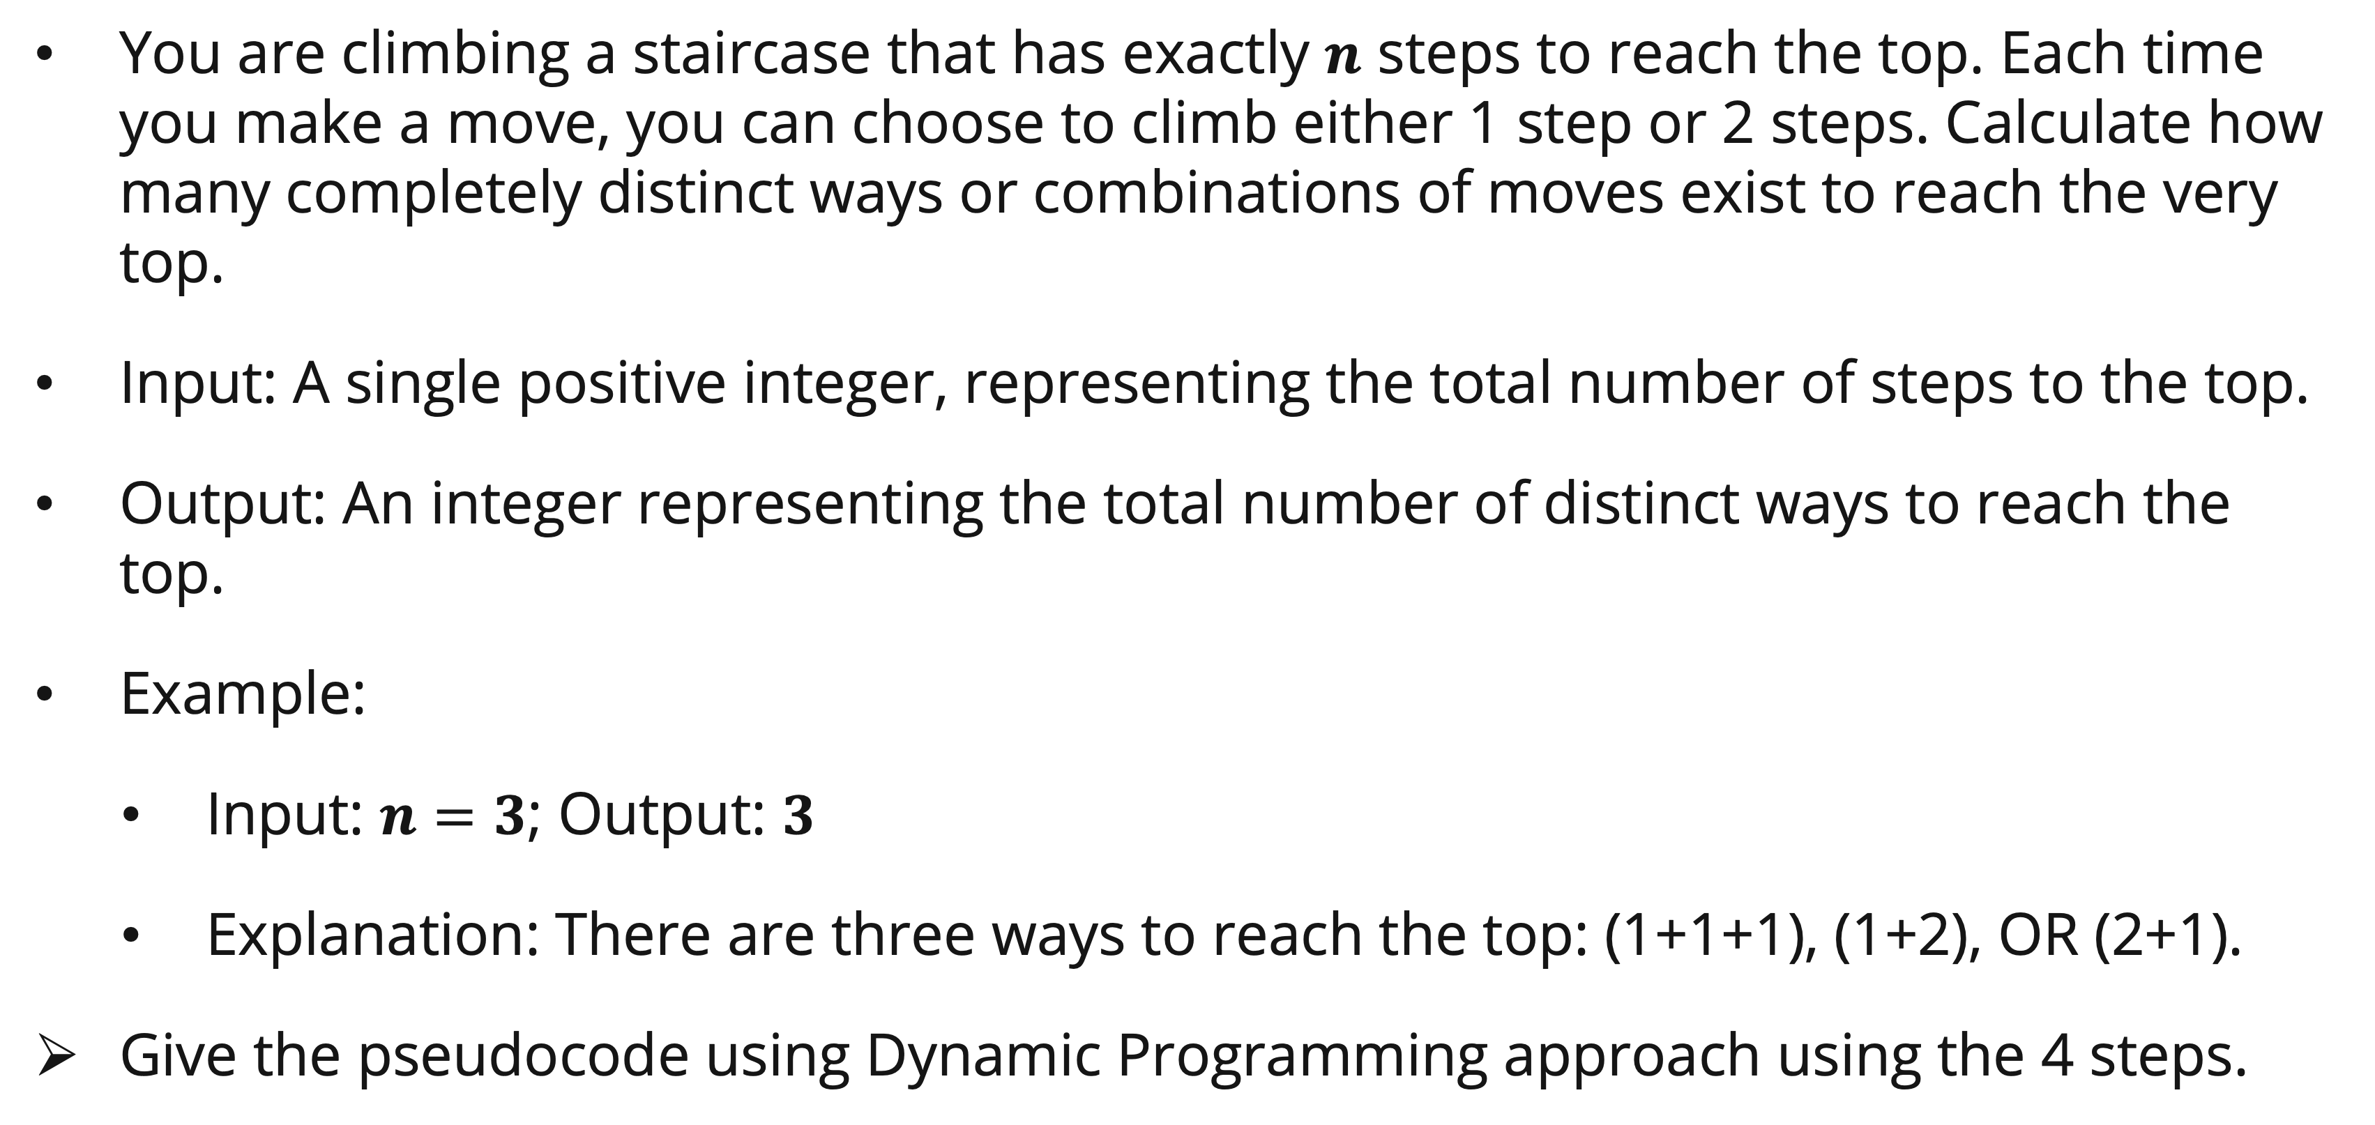
Exercise
The climbing stairs problem
You are climbing a staircase that has exactly $n$ steps to reach the top. Each time you make a move, you can choose to climb either 1 step or 2 steps. Calculate how many completely distinct ways or combinations of moves exist to reach the very top.
Input: A single positive integer, representing the total number of steps to the top.
Output: An integer representing the total number of distinct ways to reach the top.
Example:
  Input: $n=3$; Output: $3$
  Explanation: There are three ways to reach the top: (1+1+1), (1+2), OR (2+1).
Give the pseudocode using Dynamic Programming approach using the 4 steps.

Slide 31
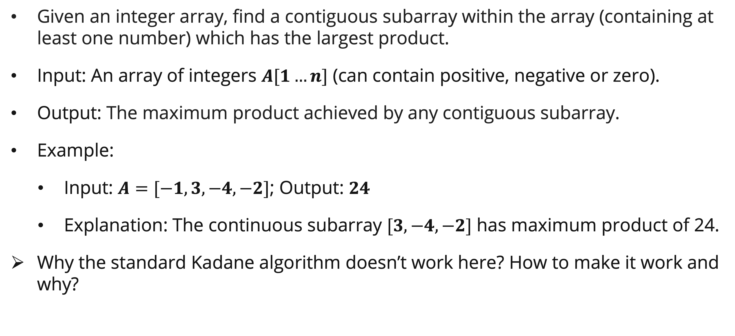
Exercise
Maximum product subarray
Given an integer array, find a contiguous subarray within the array (containing at least one number) which has the largest product.
Input: An array of integers $A[1…n]$ (can contain positive, negative or zero).
Output: The maximum product achieved by any contiguous subarray.
Example:
  Input: $A=[−1, 3, −4, −2]$; Output: $24$
  Explanation: The continuous subarray $[3, −4, −2]$ has maximum product of 24.
Why the standard Kadane algorithm doesn’t work here? How to make it work and why?

Slide 32
References
Session 15
Cormen, T.H., Leiserson, C.E., Rivest, R.L., & Stein, C. (2022). Introduction to Algorithms, 4th Edition. MIT Press. Chapter 14.3.
Skiena, S.S. (2020). The Algorithm Design Manual, 3rd Edition. Springer. Chapter 10.1.

